Slide 1
Announcements
No Friday AI seminar this week
Today 3pm EA170 – Peter Bartlett on Deep Learning
Event link

Slide 2
Feedback summary
Lectures are a little too fast, and key concepts need to be emphasized
Need a clearer connection between assignment problems and lecture concepts
Clearer instructions/explanation in assignments

Slide 3
Changes for the second half
Adding more examples to lectures
Trimmed out some material from second half of class
Adding specific learning goals for each class session
Making clearer in assignments:
What you are expected to do
How the program should behave

Slide 4
Today’s learning goals
Explain the difference between offline solving and online learning
Explain the difference between Monte Carlo and Temporal Difference learning
Distinguish between on-policy and off-policy learning approaches
Explain the four phases of a genetic algorithm

Slide 5
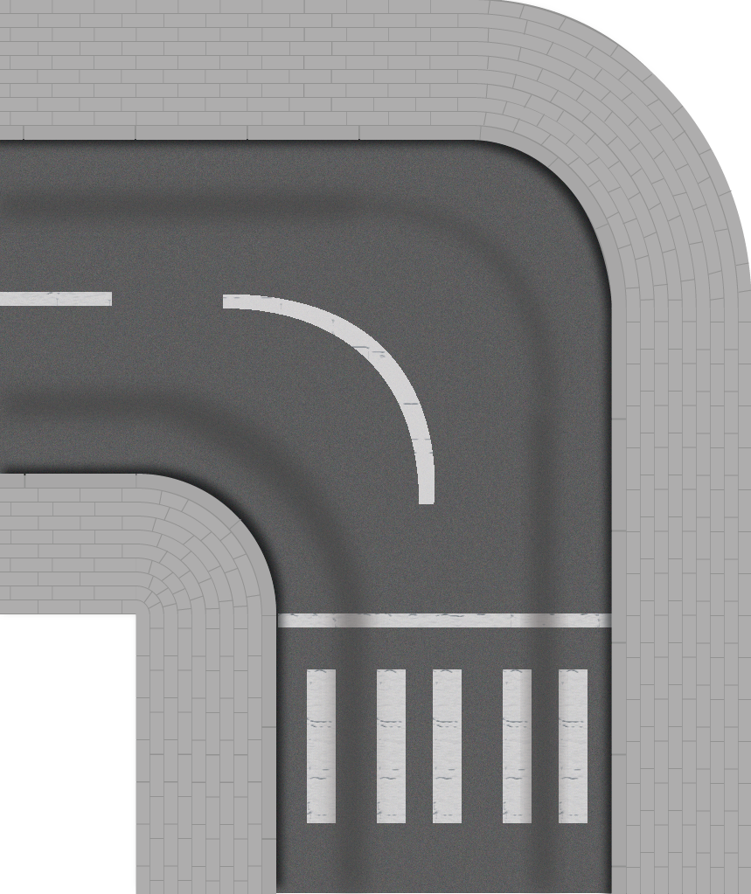

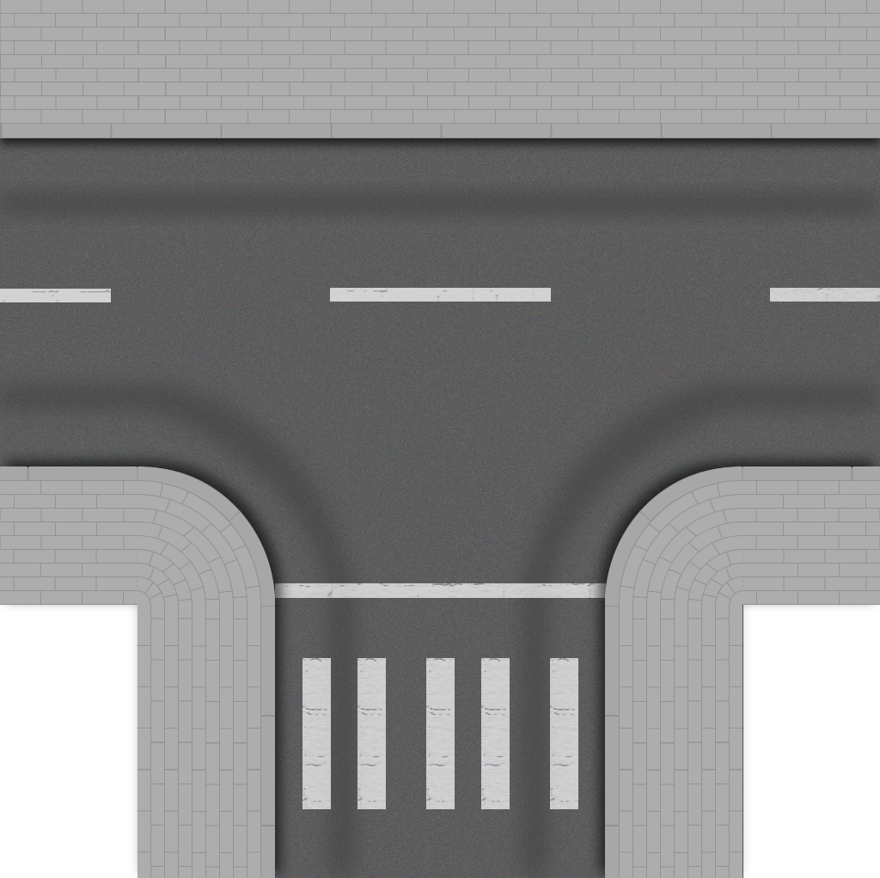

Slide 6
Reinforcement Learning examples

Slide 7





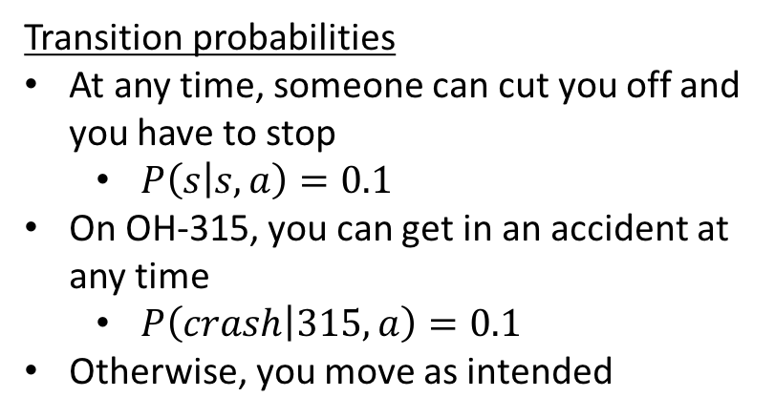
Problem: Driving home
Legal actions
Driving along the road
Intentionally getting in an accident (OH-315 only)
Transition probabilities
At any time, someone can cut you off and you have to stop
$P\left(s | s,a\right)=0.1$
On OH-315, you can get in an accident at any time
$P\left(crash | 315,a\right)=0.1$
Otherwise, you move as intended
Rewards
Get home: +10 (terminal)
Pay toll: -5
Crash: -100 (terminal)

Slide 8
Driving Home as Gridworld
Calculating optimal route from knowledge of problem
No actions taken!

Slide 9

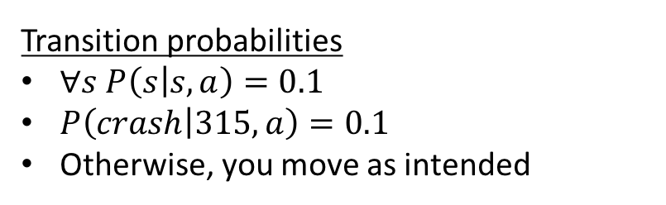
Value iteration (Offline solving)
Transition probabilities
$∀s P\left(s | s,a\right)=0.1$
$P\left(crash | 315,a\right)=0.1$
Otherwise, you move as intended
Rewards
Get home: +10 (terminal)
Pay toll: -5
Crash: -100 (terminal)
Transitions and rewards are known to the agent
We can calculate the optimal policy, without having to take any action.

Slide 10
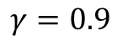
Driving Home as Gridworld
$$γ=0.9$$
Calculating optimal route from knowledge of problem
No actions taken!

Slide 11
Value iteration (Offline solving)
$$γ=0.9$$
Calculating optimal route from knowledge of problem
No actions taken!

Slide 12
Value iteration (Offline solving)
$$γ=0.9$$
Calculating optimal route from knowledge of problem
No actions taken!

Slide 13
Value iteration (Offline solving)
$$γ=0.9$$
Done calculating route
Now we follow it (as a reflex agent)!

Slide 14

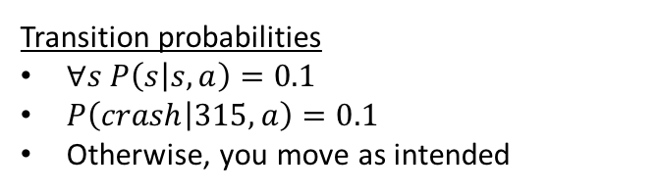
Online reinforcement learning
Transition probabilities
$∀s P\left(s | s,a\right)=0.1$
$P\left(crash | 315,a\right)=0.1$
Otherwise, you move as intended
Rewards
Get home: +10 (terminal)
Pay toll: -5
Crash: -100 (terminal)
Transitions and rewards are unknown to the agent
We must act to learn the optimal policy
Approaches
Monte Carlo (full sequences)
Temporal Difference learning (single observations)

Slide 15
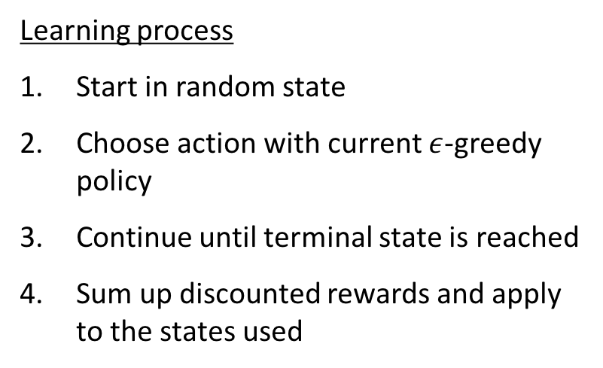
Monte Carlo
Learning process
Start in random state
Choose action with current $ε$-greedy policy
Continue until terminal state is reached
Sum up discounted rewards and apply to the states used

Slide 16
Monte Carlo
Run 1
A
O
R
-5
EX
EX
10

Slide 17
Monte Carlo
Run 1
Run 2
Run 3
A
O
R
A
O
R
A
O
R
-5
-5
EX
EX
10
EX
EX
10
EX
EX
-100

Slide 18
Monte Carlo
Run 1
Run 2
Run 3
A
O
R
A
O
R
A
O
R
-5
-5
EX
EX
10
EX
EX
10
EX
EX
-100

Slide 19
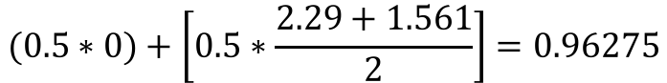
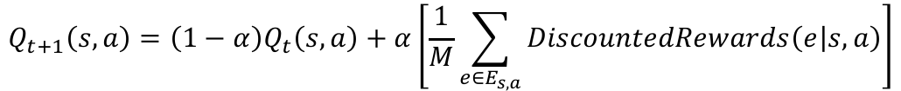
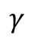
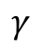
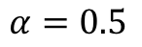
Monte Carlo
Run 1
Run 2
A
O
R
A
O
R
$$γ$$
-5
0
$$γ$$
0.9
-5
$$γ=0.9$$
0.81
0
0.9
0
$$α=0.5$$
0.729
10
0.81
0
2.29
0.729
0
0.6561
10
1.561
$$Q_{t+1}\left(s,a\right)=\left(1−α\right)Q_{t}\left(s,a\right)+α\left[\frac{1}{M}\sum_{e∈E_{s,a}}{DiscountedRewards\left(e | s,a\right)}\right]$$
$$(0.5∗0)+\left[0.5∗\frac{2.29+1.561}{2}\right]=0.96275$$

Slide 20
Monte Carlo
$$γ=0.9$$
$$α=0.5$$

Slide 21
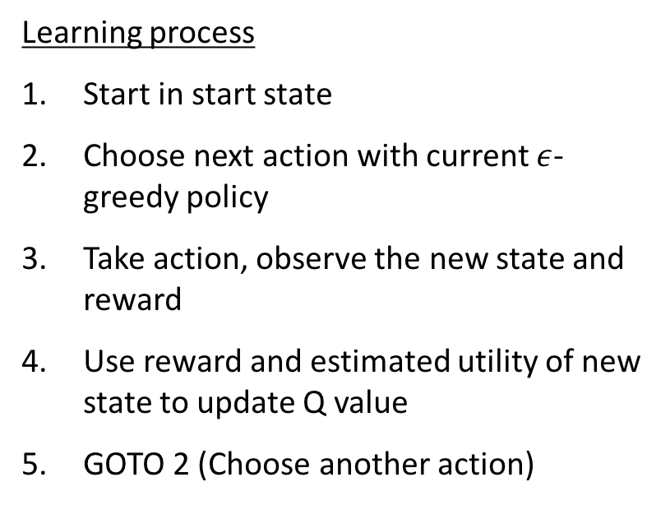
Temporal Difference learning
Now learning from every action!
Learning process
Start in start state
Choose next action with current $ε$-greedy policy
Take action, observe the new state and reward
Use reward and estimated utility of new state to update Q value
GOTO 2 (Choose another action)

Slide 22
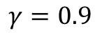
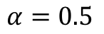
TD learning – Episode 1
Action
Outcome
Reward
Q learning update rule
$$Q\left(s,a\right)←\left(1−α\right)Q\left(s,a\right)+α\left[R\left(s^{′}\right)+γ\max_{a^{′}∈A\left(s^{′}\right)}{Q\left(s^{′},a^{′}\right)}\right]$$
$$γ=0.9$$
$$α=0.5$$

Slide 23
TD learning – Episode 1
Action
Outcome
Reward
0
Q learning update rule
$$Q\left(s,a\right)←\left(1−α\right)Q\left(s,a\right)+α\left[R\left(s^{′}\right)+γ\max_{a^{′}∈A\left(s^{′}\right)}{Q\left(s^{′},a^{′}\right)}\right]$$
$$Q\left([2,0],N\right)←\left(0.5\right)Q\left([2,0],N\right)+0.5\left[0+0.9∗max{\{0,0,0\}}\right]=0$$
$$γ=0.9$$
$$α=0.5$$

Slide 24
TD learning – Episode 1
Action
Outcome
Reward
0
Q learning update rule
$$Q\left(s,a\right)←\left(1−α\right)Q\left(s,a\right)+α\left[R\left(s^{′}\right)+γ\max_{a^{′}∈A\left(s^{′}\right)}{Q\left(s^{′},a^{′}\right)}\right]$$
$$Q\left([2,1],E\right)←\left(0.5\right)Q\left([2,1],E\right)+0.5\left[0+0.9∗max{\{0,0\}}\right]=0$$
$$γ=0.9$$
$$α=0.5$$

Slide 25
TD learning – Episode 1
Action
Outcome
Reward
-5
Q learning update rule
$$Q\left(s,a\right)←\left(1−α\right)Q\left(s,a\right)+α\left[R\left(s^{′}\right)+γ\max_{a^{′}∈A\left(s^{′}\right)}{Q\left(s^{′},a^{′}\right)}\right]$$
$$Q\left([3,1],N\right)←\left(0.5\right)Q\left([3,1],N\right)+0.5\left[−5+0.9∗max{\{0,0\}}\right]=−2.5$$
$$γ=0.9$$
$$α=0.5$$

Slide 26
TD learning – Episode 1
Action
Outcome
Reward
0
Q learning update rule
$$Q\left(s,a\right)←\left(1−α\right)Q\left(s,a\right)+α\left[R\left(s^{′}\right)+γ\max_{a^{′}∈A\left(s^{′}\right)}{Q\left(s^{′},a^{′}\right)}\right]$$
$$Q\left([3,2],N\right)←\left(0.5\right)Q\left([3,2],N\right)+0.5\left[0+0.9∗max{\{0,0\}}\right]=0$$
$$γ=0.9$$
$$α=0.5$$

Slide 27
TD learning – Episode 1
Action
Outcome
Reward
0
Q learning update rule
$$Q\left(s,a\right)←\left(1−α\right)Q\left(s,a\right)+α\left[R\left(s^{′}\right)+γ\max_{a^{′}∈A\left(s^{′}\right)}{Q\left(s^{′},a^{′}\right)}\right]$$
$$Q\left([3,3],W\right)←\left(0.5\right)Q\left([3,3],W\right)+0.5\left[0+0.9∗max{\{0\}}\right]=0$$
$$γ=0.9$$
$$α=0.5$$
Notes:
Remember, no reward for entering the goal square; only get the reward when we take the EXIT action!

Slide 28
TD learning – Episode 1
Action
EXIT
Outcome
EXIT
Reward
10
Q learning update rule
$$Q\left(s,a\right)←\left(1−α\right)Q\left(s,a\right)+α\left[R\left(s^{′}\right)+γ\max_{a^{′}∈A\left(s^{′}\right)}{Q\left(s^{′},a^{′}\right)}\right]$$
$$Q\left([2,3],EXIT\right)←\left(0.5\right)Q\left([2,3],EXIT\right)+0.5\left[10+0.9∗max{\{\}}\right]=5$$
$$γ=0.9$$
$$α=0.5$$
Notes:
Remember, no reward for entering the goal square; only get the reward when we take the EXIT action!

Slide 29
TD learning – Episode 2
Action
Outcome
Reward
Q learning update rule
$$Q\left(s,a\right)←\left(1−α\right)Q\left(s,a\right)+α\left[R\left(s^{′}\right)+γ\max_{a^{′}∈A\left(s^{′}\right)}{Q\left(s^{′},a^{′}\right)}\right]$$
$$γ=0.9$$
$$α=0.5$$

Slide 30
TD learning – Episode 2
Action
Outcome
Reward
0
Q learning update rule
$$Q\left(s,a\right)←\left(1−α\right)Q\left(s,a\right)+α\left[R\left(s^{′}\right)+γ\max_{a^{′}∈A\left(s^{′}\right)}{Q\left(s^{′},a^{′}\right)}\right]$$
$$Q\left([2,0],N\right)←\left(0.5\right)Q\left([2,0],N\right)+0.5\left[0+0.9∗max{\{0,0,0\}}\right]=0$$
$$γ=0.9$$
$$α=0.5$$

Slide 31
TD learning – Episode 2
Action
Outcome
Reward
0
Q learning update rule
$$Q\left(s,a\right)←\left(1−α\right)Q\left(s,a\right)+α\left[R\left(s^{′}\right)+γ\max_{a^{′}∈A\left(s^{′}\right)}{Q\left(s^{′},a^{′}\right)}\right]$$
$$Q\left([2,1],E\right)←\left(0.5\right)Q\left([2,1],E\right)+0.5\left[0+0.9∗max{\{0,−2.5\}}\right]=0$$
$$γ=0.9$$
$$α=0.5$$

Slide 32
TD learning – Episode 2
Action
Outcome
Reward
-5
Q learning update rule
$$Q\left(s,a\right)←\left(1−α\right)Q\left(s,a\right)+α\left[R\left(s^{′}\right)+γ\max_{a^{′}∈A\left(s^{′}\right)}{Q\left(s^{′},a^{′}\right)}\right]$$
$$Q\left([3,1],N\right)←\left(0.5\right)Q\left([3,1],N\right)+0.5\left[−5+0.9∗\max{\{0,0\}}\right]=−3.75$$
$$γ=0.9$$
$$α=0.5$$

Slide 33
TD learning – Episode 2
Action
Outcome
Reward
0
Q learning update rule
$$Q\left(s,a\right)←\left(1−α\right)Q\left(s,a\right)+α\left[R\left(s^{′}\right)+γ\max_{a^{′}∈A\left(s^{′}\right)}{Q\left(s^{′},a^{′}\right)}\right]$$
$$Q\left([3,2],N\right)←\left(0.5\right)Q\left([3,2],N\right)+0.5\left[0+0.9∗max{\{0,0\}}\right]=0$$
$$γ=0.9$$
$$α=0.5$$

Slide 34
TD learning – Episode 2
Action
Outcome
Reward
0
Q learning update rule
$$Q\left(s,a\right)←\left(1−α\right)Q\left(s,a\right)+α\left[R\left(s^{′}\right)+γ\max_{a^{′}∈A\left(s^{′}\right)}{Q\left(s^{′},a^{′}\right)}\right]$$
$$Q\left([3,3],W\right)←\left(0.5\right)Q\left([3,3],W\right)+0.5\left[0+0.9∗max{\{5\}}\right]=2.25$$
$$γ=0.9$$
$$α=0.5$$
Notes:
Remember, no reward for entering the goal square; only get the reward when we take the EXIT action!

Slide 35
TD learning – Episode 2
Action
EXIT
Outcome
EXIT
Reward
10
Q learning update rule
$$Q\left(s,a\right)←\left(1−α\right)Q\left(s,a\right)+α\left[R\left(s^{′}\right)+γ\max_{a^{′}∈A\left(s^{′}\right)}{Q\left(s^{′},a^{′}\right)}\right]$$
$Q\left([2,3],EXIT\right)←\left(0.5\right)Q\left([2,3],EXIT\right)+0.5\left[10+0.9∗max{\{\}}\right]=$7.5
$$γ=0.9$$
$$α=0.5$$
Notes:
Remember, no reward for entering the goal square; only get the reward when we take the EXIT action!

Slide 36
TD learning – Episode 2
Monte Carlo
TD Learning
$$γ=0.9$$
$$α=0.5$$
Notes:
Note the differences between Monte Carlo and TD learning for these cells?
Why does Monte carlo have higher values?
Will these values ever be the same?

Slide 37
TD learning – Episode 3
Action
Outcome
Reward
Q learning update rule
$$Q\left(s,a\right)←\left(1−α\right)Q\left(s,a\right)+α\left[R\left(s^{′}\right)+γ\max_{a^{′}∈A\left(s^{′}\right)}{Q\left(s^{′},a^{′}\right)}\right]$$
$$γ=0.9$$
$$α=0.5$$
Notes:
One more episode of TD learning, now with some actions that don’t work right

Slide 38
TD learning – Episode 3
Action
Outcome
Reward
0
Q learning update rule
$$Q\left(s,a\right)←\left(1−α\right)Q\left(s,a\right)+α\left[R\left(s^{′}\right)+γ\max_{a^{′}∈A\left(s^{′}\right)}{Q\left(s^{′},a^{′}\right)}\right]$$
$$Q\left([2,0],N\right)←\left(0.5\right)Q\left([2,0],N\right)+0.5\left[0+0.9∗max{\{0,0,0\}}\right]=0$$
$$γ=0.9$$
$$α=0.5$$

Slide 39
TD learning – Episode 3
Action
Outcome
Reward
0
Q learning update rule
$$Q\left(s,a\right)←\left(1−α\right)Q\left(s,a\right)+α\left[R\left(s^{′}\right)+γ\max_{a^{′}∈A\left(s^{′}\right)}{Q\left(s^{′},a^{′}\right)}\right]$$
$$Q\left([2,1],E\right)←\left(0.5\right)Q\left([2,1],E\right)+0.5\left[0+0.9∗max{\{0,−3.75\}}\right]=0$$
$$γ=0.9$$
$$α=0.5$$

Slide 40
TD learning – Episode 3
Action
Outcome
Reward
-5
Q learning update rule
$$Q\left(s,a\right)←\left(1−α\right)Q\left(s,a\right)+α\left[R\left(s^{′}\right)+γ\max_{a^{′}∈A\left(s^{′}\right)}{Q\left(s^{′},a^{′}\right)}\right]$$
$$Q\left([3,1],N\right)←\left(0.5\right)Q\left([3,1],N\right)+0.5\left[−5+0.9∗\max{\{0,0\}}\right]=−4.375$$
$$γ=0.9$$
$$α=0.5$$

Slide 41
TD learning – Episode 3
Action
Outcome
Reward
-5
Q learning update rule
$$Q\left(s,a\right)←\left(1−α\right)Q\left(s,a\right)+α\left[R\left(s^{′}\right)+γ\max_{a^{′}∈A\left(s^{′}\right)}{Q\left(s^{′},a^{′}\right)}\right]$$
$$Q\left([3,2],N\right)←\left(0.5\right)Q\left([3,2],N\right)+0.5\left[−5+0.9∗max{\{0,0\}}\right]=−2.5$$
$$γ=0.9$$
$$α=0.5$$
Notes:
By failing to go north and having to go through the toll booth again, we (1) get the negative reward and (2) now have it applied to leaving the square

Slide 42
TD learning – Episode 3
Action
Outcome
Reward
0
Q learning update rule
$$Q\left(s,a\right)←\left(1−α\right)Q\left(s,a\right)+α\left[R\left(s^{′}\right)+γ\max_{a^{′}∈A\left(s^{′}\right)}{Q\left(s^{′},a^{′}\right)}\right]$$
$$Q\left([3,2],N\right)←\left(0.5\right)Q\left([3,2],N\right)+0.5\left[0+0.9∗max{\{0,2.25\}}\right]=−0.2375$$
$$γ=0.9$$
$$α=0.5$$
Notes:
But now the potential positive outcome from [3,3] propagates back to the North action from [3,2], bringing it back towards 0

Slide 43
TD learning – Episode 3
Action
Outcome
Reward
0
Q learning update rule
$$Q\left(s,a\right)←\left(1−α\right)Q\left(s,a\right)+α\left[R\left(s^{′}\right)+γ\max_{a^{′}∈A\left(s^{′}\right)}{Q\left(s^{′},a^{′}\right)}\right]$$
$$Q\left([3,3],W\right)←\left(0.5\right)Q\left([3,3],W\right)+0.5\left[0+0.9∗max{\{0,2.25\}}\right]=2.1375$$
$$γ=0.9$$
$$α=0.5$$
Notes:
Here, failing to go West reduces the value of ([3,3], West)

Slide 44
TD learning – Episode 3
Action
Outcome
Reward
0
Q learning update rule
$$Q\left(s,a\right)←\left(1−α\right)Q\left(s,a\right)+α\left[R\left(s^{′}\right)+γ\max_{a^{′}∈A\left(s^{′}\right)}{Q\left(s^{′},a^{′}\right)}\right]$$
$$Q\left([3,3],W\right)←\left(0.5\right)Q\left([3,3],W\right)+0.5\left[0+0.9∗max{\{7.5\}}\right]=4.44375$$
$$γ=0.9$$
$$α=0.5$$
Notes:
But now, we know the exit square is good, so we increase ([3,3], West) again

Slide 45
TD learning – Episode 3
Action
EXIT
Outcome
EXIT
Reward
10
Q learning update rule
$$Q\left(s,a\right)←\left(1−α\right)Q\left(s,a\right)+α\left[R\left(s^{′}\right)+γ\max_{a^{′}∈A\left(s^{′}\right)}{Q\left(s^{′},a^{′}\right)}\right]$$
$$Q\left([2,3],EXIT\right)←\left(0.5\right)Q\left([2,3],EXIT\right)+0.5\left[10+0.9∗max{\{\}}\right]=8.75$$
$$γ=0.9$$
$$α=0.5$$
Notes:
Remember, no reward for entering the goal square; only get the reward when we take the EXIT action!

Slide 46
Temporal Difference learning
Now learning from every action!
Learning process
Start in start state
Choose next action with current $ε$-greedy policy
Take action, observe the new state and reward
Use reward and estimated utility of new state to update Q value
GOTO 2 (Choose another action)

Slide 47
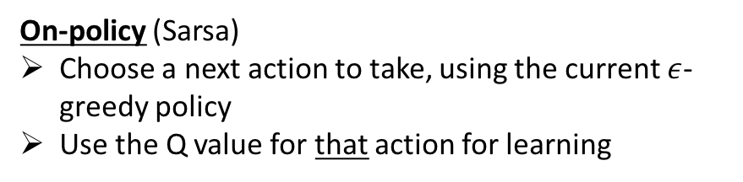
TD learning – On-policy vs Off-policy
Two different ways of getting estimated utility
Off-policy (Q learning)
Look at all the actions you can do in this state, and use the highest of their Q values for learning
$$Q\left(s,a\right)←\left(1−α\right)Q\left(s,a\right)+α\left[R\left(s^{′}\right)+γ\max_{a^{′}∈A\left(s^{′}\right)}{Q\left(s^{′},a^{′}\right)}\right]$$
On-policy (Sarsa)
Choose a next action to take, using the current $ε$-greedy policy
Use the Q value for that action for learning
What we’ve been doing in the example is off policy learning!
$$Q\left(s,a;a′\right)←\left(1−α\right)Q\left(s,a\right)+α\left[R\left(s^{′}\right)+γQ(s^{′},a^{′})\right]$$
Notes:
Remember, no reward for entering the goal square; only get the reward when we take the EXIT action!

Slide 48
Off-policy vs On-policy learning process
On-policy
Take an action
Observe a reward
Choose the next action
Learn (using chosen action)
Take the next action
Off-policy
Take an action
Observe a reward
Learn (using best action)
Choose the next action
Take the next action

Slide 49
TD learning – Off-policy
Action
Outcome
Reward
0
Q learning update rule
$$Q\left(s,a\right)←\left(1−α\right)Q\left(s,a\right)+α\left[R\left(s^{′}\right)+γ\max_{a^{′}∈A\left(s^{′}\right)}{Q\left(s^{′},a^{′}\right)}\right]$$
$$Q\left([2,1],E\right)←\left(0.5\right)Q\left([2,1],E\right)+0.5\left[0+0.9∗max{\{0,−2.5\}}\right]=0$$
$$γ=0.9$$
$$α=0.5$$

Slide 50
TD learning – On-policy
Action
Outcome
Reward
0
Sarsa update rule
$$Q\left(s,a;a′\right)←\left(1−α\right)Q\left(s,a\right)+α\left[R\left(s^{′}\right)+γQ(s^{′},a^{′})\right]$$
$$Q\left(\left[2,1\right],E;N\right)←\left(0.5\right)Q\left([2,1],E\right)+0.5\left[0+0.9∗−2.5\right]=−1.125$$
$$γ=0.9$$
$$α=0.5$$
Notes:
We chose N as the next action, using the current \epsilon-greedy policy

Slide 51
RL Concepts
Offline solving vs online learning
Offline – problem is known (transitions and rewards), can determine optimal policy without taking action
Online – problem is unknown, need to act to learn info about transitions and rewards

Slide 52
RL Concepts
Monte Carlo vs Temporal Difference
Monte Carlo – learn from multiple complete training episodes
Run from random start to finish
For each state/action pair, average the sum of discounted rewards after observing it to get new Q values
Temporal Difference – learn from every individual experience
Take action a to leave state s, end up in s’ with reward R(s’)
Use observed reward and current estimated values of each next action to update value of previous state/action pair
Can be used with infinite-length problems!

Slide 53
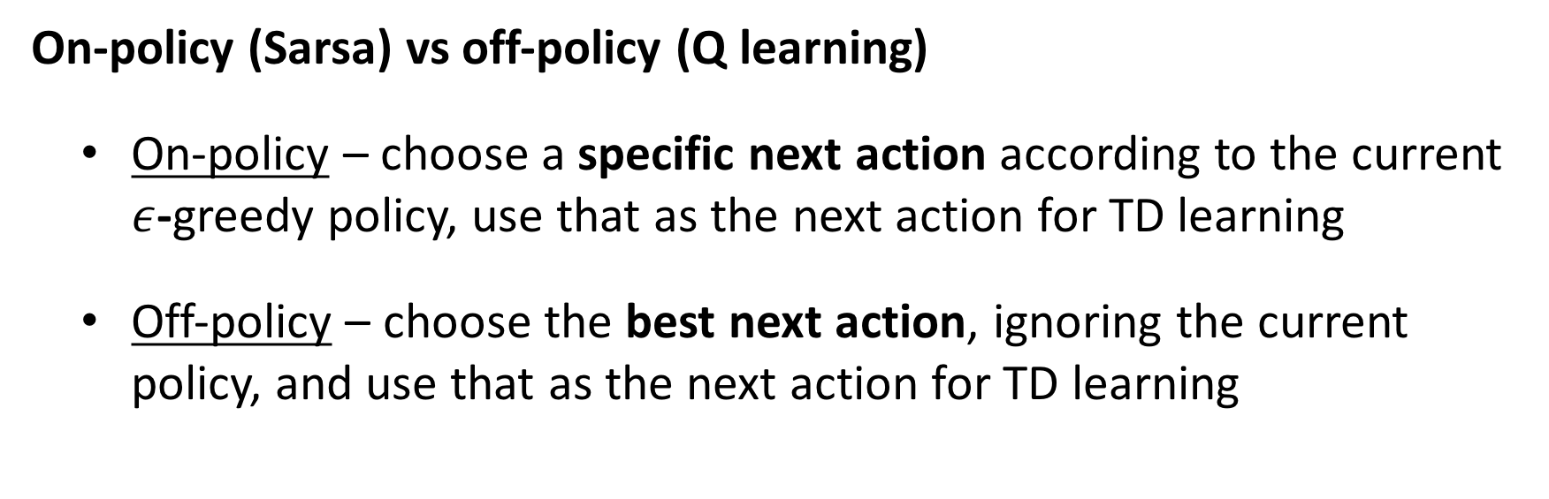
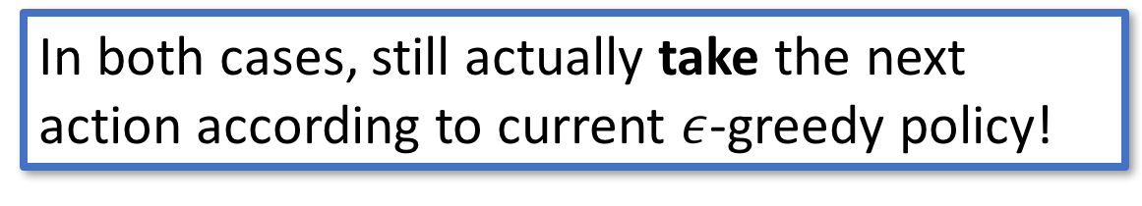
RL Concepts
On-policy (Sarsa) vs off-policy (Q learning)
On-policy – choose a specific next action according to the current $ε$-greedy policy, use that as the next action for TD learning
Off-policy – choose the best next action, ignoring the current policy, and use that as the next action for TD learning
In both cases, still actually take the next action according to current $ε$-greedy policy!

Slide 54
Genetic algorithms
http://rednuht.org/genetic_walkers/

Slide 55
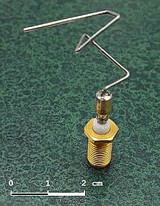
Genetic algorithms
Setup
There’s a problem that you want to solve (e.g., making an antenna), but you’re not sure how best to search the model space.
Idea
Start with a whole bunch of different models
Find which ones work and cross-breed them
Include mutation for random outcomes

Slide 56
Main steps
Evaluate fitness of current population
Select the fittest, remove the rest
Crossover
Mutation

Slide 57
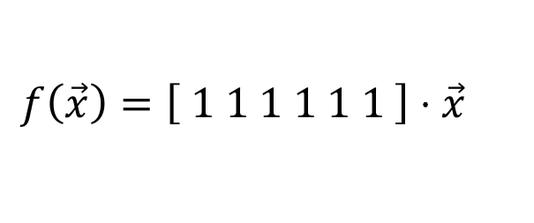
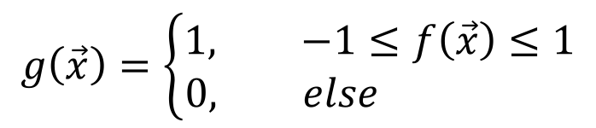
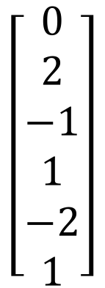

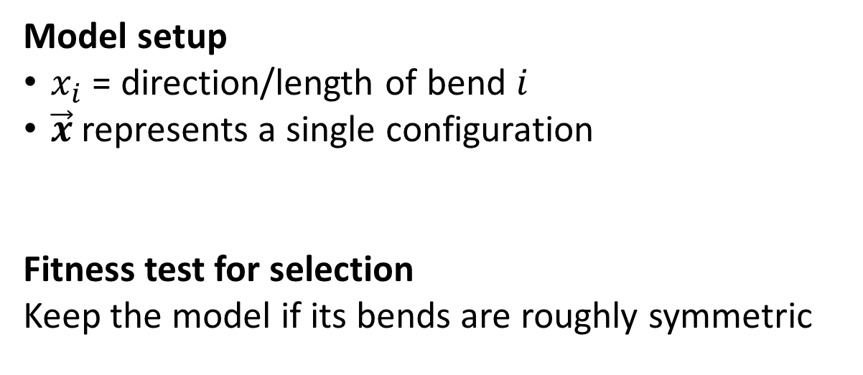
Example: Antenna
Model setup
$x_{i}$ = direction/length of bend $i$
$\vec{x}$ represents a single configuration
Fitness test for selection
Keep the model if its bends are roughly symmetric
$$\left[\begin{matrix}0 \\ 2 \\ −1 \\ 1 \\ −2 \\ 1\end{matrix}\right]$$
$$⇔$$
$$f\left(\vec{x}\right)=\left[ 1 1 1 1 1 1 \right]⋅\vec{x}$$
$$g\left(\vec{x}\right)=\left\{\begin{aligned}1, −1≤f\left(\vec{x}\right)≤1 \\ 0, else \end{aligned}\right.$$

Slide 58
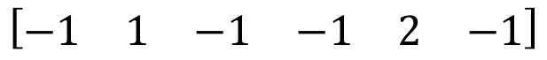
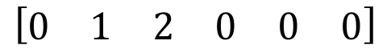
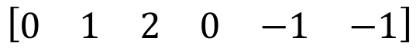
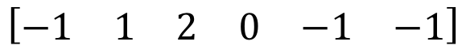
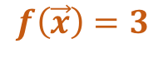
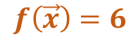
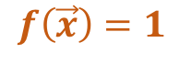
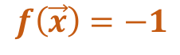
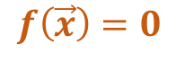
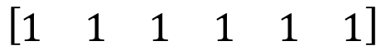
Antenna: Evaluation
Current population
$$\left[\begin{matrix}0 & 1 & 2 & 0 & 0 & 0\end{matrix}\right]$$
$$f\left(\vec{x}\right)=3$$
$$\left[\begin{matrix}1 & 1 & 1 & 1 & 1 & 1\end{matrix}\right]$$
$$\left[\begin{matrix}0 & 1 & 2 & 0 & −1 & −1\end{matrix}\right]$$
$$f\left(\vec{x}\right)=6$$
$$f\left(\vec{x}\right)=1$$
$$\left[\begin{matrix}−1 & 1 & −1 & −1 & 2 & −1\end{matrix}\right]$$
$$f\left(\vec{x}\right)=−1$$
$$\left[\begin{matrix}−1 & 1 & 2 & 0 & −1 & −1\end{matrix}\right]$$
$$f\left(\vec{x}\right)=0$$

Slide 59
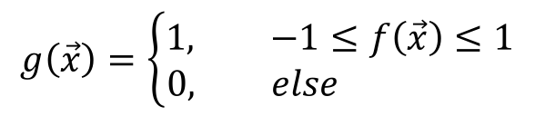
Antenna: Selection
$$g\left(\vec{x}\right)=\left\{\begin{aligned}1, −1≤f\left(\vec{x}\right)≤1 \\ 0, else \end{aligned}\right.$$
Current population
$$\left[\begin{matrix}0 & 1 & 2 & 0 & 0 & 0\end{matrix}\right]$$
$$f\left(\vec{x}\right)=3$$
$$\left[\begin{matrix}1 & 1 & 1 & 1 & 1 & 1\end{matrix}\right]$$
$$\left[\begin{matrix}0 & 1 & 2 & 0 & −1 & −1\end{matrix}\right]$$
$$f\left(\vec{x}\right)=6$$
$$f\left(\vec{x}\right)=1$$
$$\left[\begin{matrix}−1 & 1 & −1 & −1 & 2 & −1\end{matrix}\right]$$
$$f\left(\vec{x}\right)=−1$$
$$\left[\begin{matrix}−1 & 1 & 2 & 0 & −1 & −1\end{matrix}\right]$$
$$f\left(\vec{x}\right)=0$$

Slide 60
Antenna: Crossover
Current population
$$\left[\begin{matrix}0 & 1 & 2 & 0 & −1 & −1\end{matrix}\right]$$
$$\left[\begin{matrix}−1 & 1 & −1 & −1 & 2 & −1\end{matrix}\right]$$
$$\left[\begin{matrix}−1 & 1 & 2 & 0 & −1 & −1\end{matrix}\right]$$

Slide 61
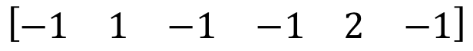
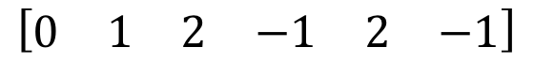
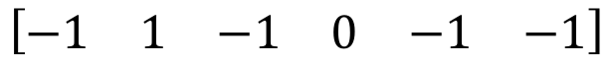
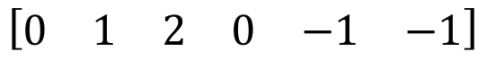
Antenna: Crossover
Split each model in half
Take the first half of model 1 and second half of model 2, add to the population
Take the first half of model 2 and second half of model 1, add to the population
Added to population
$$\left[\begin{matrix}0 & 1 & 2 & −1 & 2 & −1\end{matrix}\right]$$
$$\left[\begin{matrix}0 & 1 & 2 & 0 & −1 & −1\end{matrix}\right]$$
$$\left[\begin{matrix}−1 & 1 & −1 & 0 & −1 & −1\end{matrix}\right]$$
$$\left[\begin{matrix}−1 & 1 & −1 & −1 & 2 & −1\end{matrix}\right]$$

Slide 62
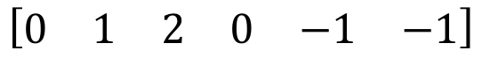
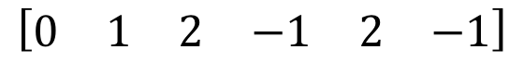
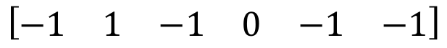
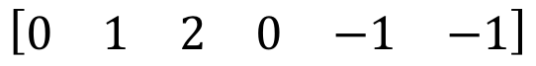
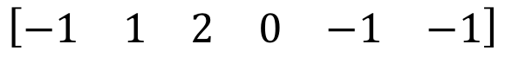
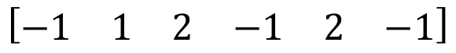
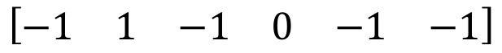
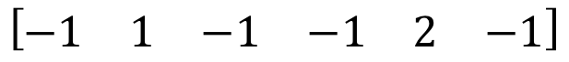
Antenna: Crossover
Current population
$$\left[\begin{matrix}0 & 1 & 2 & −1 & 2 & −1\end{matrix}\right]$$
$$\left[\begin{matrix}−1 & 1 & −1 & 0 & −1 & −1\end{matrix}\right]$$
$$\left[\begin{matrix}−1 & 1 & −1 & 0 & −1 & −1\end{matrix}\right]$$
$$\left[\begin{matrix}0 & 1 & 2 & 0 & −1 & −1\end{matrix}\right]$$
$$\left[\begin{matrix}−1 & 1 & 2 & −1 & 2 & −1\end{matrix}\right]$$
$$\left[\begin{matrix}−1 & 1 & 2 & 0 & −1 & −1\end{matrix}\right]$$
Newly-added
Original
$$\left[\begin{matrix}0 & 1 & 2 & 0 & −1 & −1\end{matrix}\right]$$
$$\left[\begin{matrix}−1 & 1 & 2 & 0 & −1 & −1\end{matrix}\right]$$
$$\left[\begin{matrix}−1 & 1 & −1 & −1 & 2 & −1\end{matrix}\right]$$

Slide 63
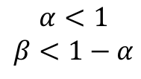
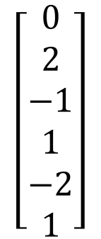
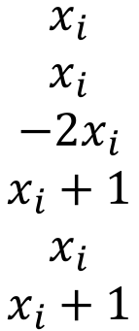
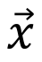




Antenna: Mutation
In each model generated by crossover, mutate model parameters at random
Example mutation function
$$M\left(x_{i}\right)=\left\{\begin{aligned}x_{i}+1, with probability α \\ −2∗x_{i}, with probability β \\ x_{i}, else \end{aligned}\right.$$
$$α<1$$
$$β<1−α$$
Example mutation
$$\vec{x}$$
Mutations
$$M(\vec{x})$$
$$\left[\begin{matrix}0 \\ 2 \\ −1 \\ 1 \\ −2 \\ 1\end{matrix}\right]$$
$$\left.\begin{matrix}x_{i} \\ x_{i} \\ −2x_{i} \\ x_{i}+1 \\ x_{i} \\ x_{i}+1\end{matrix}\right.$$
$$\left[\begin{matrix}0 \\ 2 \\ 2 \\ 2 \\ −2 \\ 2\end{matrix}\right]$$
$$α=0.25$$
$$β=0.25$$

Slide 64




Antenna: Mutation
Current population
$$\left[\begin{matrix}0 & 1 & −4 & −1 & 2 & −1\end{matrix}\right]$$
$$\left[\begin{matrix}−1 & 1 & −1 & 0 & −1 & −1\end{matrix}\right]$$
$$\left[\begin{matrix}−1 & 1 & 2 & 0 & −1 & −1\end{matrix}\right]$$
$$\left[\begin{matrix}0 & −2 & 2 & 0 & 0 & −1\end{matrix}\right]$$
$$\left[\begin{matrix}−1 & 1 & 2 & −1 & 3 & −1\end{matrix}\right]$$
$$\left[\begin{matrix}−1 & 1 & 2 & 0 & −1 & −1\end{matrix}\right]$$
$$\left[\begin{matrix}0 & 1 & 2 & 0 & −1 & −1\end{matrix}\right]$$
$$\left[\begin{matrix}−1 & 1 & 2 & 0 & −1 & −1\end{matrix}\right]$$
$$\left[\begin{matrix}−1 & 1 & −1 & −1 & 2 & −1\end{matrix}\right]$$

Slide 65













Antenna: Back to evaluation
Current population
$$\left[\begin{matrix}0 & 1 & −4 & −1 & 2 & −1\end{matrix}\right]$$
$$f\left(\vec{x}\right)=−3$$
$$\left[\begin{matrix}−1 & 1 & −1 & 0 & −1 & −1\end{matrix}\right]$$
$$\left[\begin{matrix}−1 & 1 & 2 & 0 & −1 & −1\end{matrix}\right]$$
$$f\left(\vec{x}\right)=−3$$
$$f\left(\vec{x}\right)=0$$
$$\left[\begin{matrix}0 & −2 & 2 & 0 & 0 & −1\end{matrix}\right]$$
$$\left[\begin{matrix}−1 & 1 & 2 & −1 & 3 & −1\end{matrix}\right]$$
$$f\left(\vec{x}\right)=−1$$
$$\left[\begin{matrix}−1 & 1 & 2 & 0 & −1 & −1\end{matrix}\right]$$
$$f\left(\vec{x}\right)=3$$
$$f\left(\vec{x}\right)=0$$
$$\left[\begin{matrix}0 & 1 & 2 & 0 & −1 & −1\end{matrix}\right]$$
$$\left[\begin{matrix}−1 & 1 & 2 & 0 & −1 & −1\end{matrix}\right]$$
$$f\left(\vec{x}\right)=1$$
$$f\left(\vec{x}\right)=0$$
$$\left[\begin{matrix}−1 & 1 & −1 & −1 & 2 & −1\end{matrix}\right]$$
$$f\left(\vec{x}\right)=−1$$

Slide 66
Recap: main steps
Evaluate fitness of current population
Select the fittest, remove the rest
Crossover
Mutation
Two main choices to make:
Good fitness test
Good mutation strategy

Slide 67
Choosing a good fitness test
Example was “Is it symmetrically bent?”
But this probably isn’t a very good test for how well the antenna works!
Better examples (using simulation):
Send a signal to the antenna, check accuracy of receipt
Send a signal from the antenna, see how far it goes
In general, design a fitness test that evaluates performance on the target problem

Slide 68
Choosing a good mutation strategy
Same tradeoff as in Reinforcement Learning:
Exploration vs Exploitation
High mutation rate
More likely to make big changes to escape current problems
More likely to lose current good models
Low mutation rate
Better for fine-tuning current good models
But much harder to escape current problems

Slide 69


Mutation rate - high
$$f(\vec{x};x_{i})$$
Worse
$$x_{i}$$
Better
Notes:
Good! Escaped the local solution for a better solution.

Slide 70
Mutation rate - high
$$f(\vec{x};x_{i})$$
Worse
$$x_{i}$$
Better
Notes:
Bad! Overshot the local good solution.

Slide 71
Mutation rate - low
$$f(\vec{x};x_{i})$$
Worse
$$x_{i}$$
Better
Notes:
Good! Found the best local solution.

Slide 72
Mutation rate - low
$$f(\vec{x};x_{i})$$
Worse
$$x_{i}$$
Better
Notes:
Bad! Hard to get out of the local not-as-good solution.

Slide 73
Genetic algorithms recap
Each iteration
Evaluate fitness of population
Select the fittest, remove the rest
Crossover
Mutation
Use a fitness test that evaluates performance on the target problem
High mutation rate – big changes
Escape current problems
But lose current good models
Low mutation rate – small changes
Fine-tune current good models
Hard to escape current problems

Slide 74
5 minute worksheet

Slide 75
Next time
Probability fundamentals
Count and divide
Conditional probability and Bayes Rule

